Slide 1

Unit-3: Multiple access in Wireless System
Mobile Computing Wireless Communication
(MCWC)
GTU # 3170710
PART-2 : GPRS
Prof.Swati R Sharma
Computer Engineering Department
swati.sharma@darshan.ac.in
(O) 9727747317

Slide 2
GPRS

Looping
Topics to be covered
GPRS and packet data network
GPRS network architecture
GPRS network operation
data services in GPRS
Applications of GPRS
Billing and charging in GPRS

Slide 3
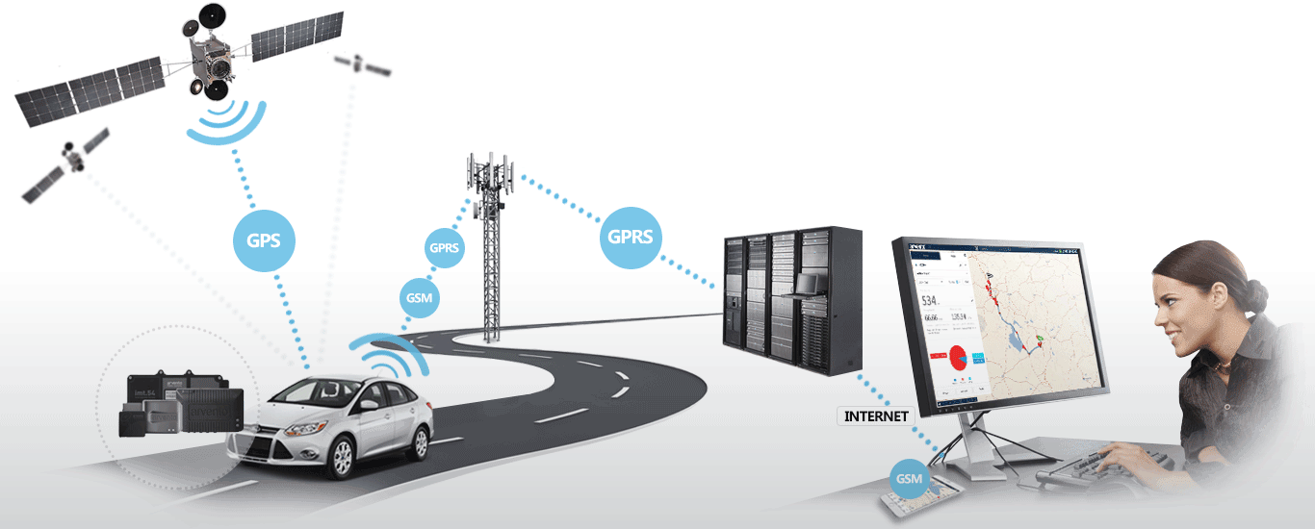
GPRS
Notes:
GPRS(114Kbps) < EGDE(368Kbps) < 3G(3.1Mbps) < HSDPA(14Mbps) < HSPA+(168Mbps) < 4G/LTE(299.6Mbps)

Slide 4
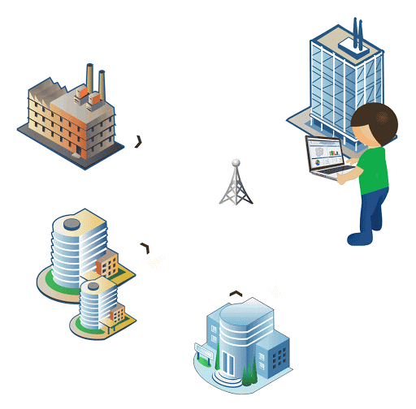
General Packet Radio Service - GPRS
GPRS defined as an efficient transport high-speed data over the current GSM and TDMA-based wireless network infrastructures.
GPRS was built up by European Telecommunications Standards Institute (ETSI).
General Packet Radio System (GPRS) is also known as is a third-generation step toward internet access.
Deployment of GPRS networks allows a variety of new applications ranging from mobile e-commerce to mobile corporate VPN access.
It is basically a packet-oriented mobile data standard on the 2G and 3G cellular communication.
Used for mobile internet, MMS and other data communications.

Slide 5
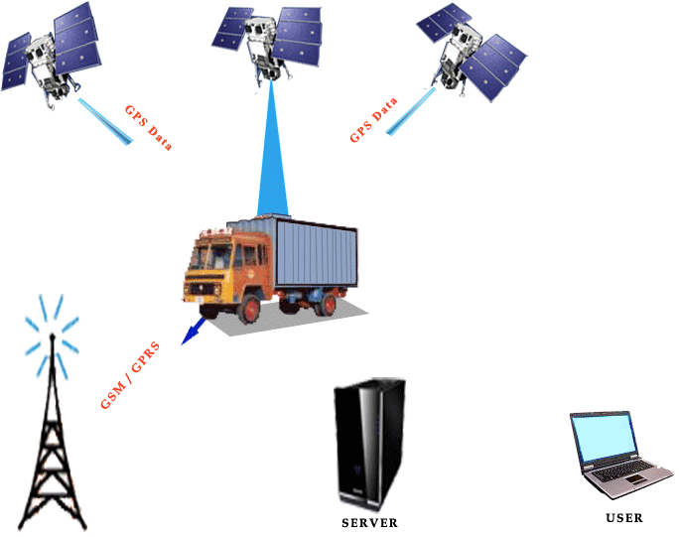
General Packet Radio Service - GPRS
Value added service to 2G to connect users to IP (Internet Protocol) -based data networks.
GPRS offers for data speeds of 14.4 Kbps to 171.2 Kbps, which allow for comfortable Internet access.
For example, e-mail and web browsing, as well as large volumes of data.
It is not the replacement of GSM but an extension of it.

Slide 6
GPRS key features
There are 3 key features as follows:
The always online feature - Removes the dial-up process, making applications only one click away.
An upgrade to existing systems - Operators do not have to replace their equipment; rather, GPRS is added on top of the existing infrastructure.
An integral part of future 3G systems - GPRS is the packet data core network for 3G systems EDGE and WCDMA.

Slide 7
GPRS Characteristics

Slide 8
GPRS Characteristics
GPRS uses packet switched resource allocation
resources allocated only when data is to be sent/received
Flexible channel allocation
one to eight time slots
available resources shared by active users
up and down link channels reserved separately
GPRS and circuit switched GSM services can use same time slots alternatively
Traffic characteristics suitable for GPRS
Intermittent, burst data transmissions
Frequent transmissions of small volumes of data
Infrequent transmission of larger volumes of data

Slide 9
GPRS Architecture

Slide 10
GPRS network architecture
GPRS uses the GSM architecture for voice.
To offer packet data services through GPRS, a new class of network nodes called GPRS support nodes (GSN).
GSNs are responsible for the delivery and routing of data packets between the mobile stations and the external packet data networks (PDN).
GPRS Support Node
Serving GSN SGSN
Gateway GSN GGSN

Slide 11
GPRS Architecture
GGSN
Other GPRS PLMN
SMS-GMSC
SMS-IWMSC
BSC
BTS
GGSN
Internet/
ISDN/PDN
MSC
SGSN
VLR
BSC
BTS
HLR
AUC
BTS
EIR

Slide 12
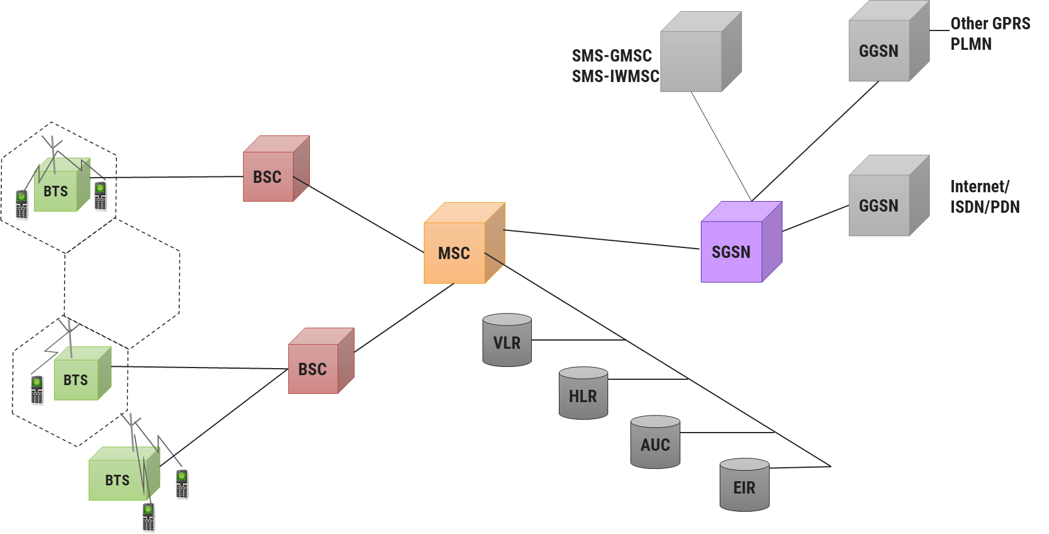
GPRS Architecture
GPRS architecture works on the same procedure like GSM network, but, has additional entities that allow packet data transmission.
Together with the packet data transport the GSM network accommodates multiple users to share the same air interface resources concurrently.
GPRS attempts to reuse the existing GSM network.
Moreover, to effectively build a packet-based mobile cellular network, some new network elements, interfaces, and protocols for handling packet traffic are required.

Slide 13
GPRS Architecture: SGSN
Serving GPRS Support Node
SGSN is at the same hierarchical level as the MSC, so whatever MSC does for voice, SGSN does for packet data.
SGSN’s tasks includes:
Packet switching
Routing and transfer
Mobility management
Logical link management
Authentication and Charging functions
SGSN processes the registration of new mobile subscribers and keeps a record of their location within a given service area.
Location register of the SGSN stores location information (like a current cell, current VLR, etc.) and user profiles of all GPRS users registered with this SGSN.
SGSN sends queries to HLR to obtain profile data of GPRS subscribers.

Slide 14
GPRS Architecture: GGSN
Gateway GPRS Support Node
GGSN acts as an interface between the GPRS backbone network and the external packet data networks.
GGSN’s functions are similar to the router in a LAN.
GGSN maintains routing information that is necessary to tunnel the Protocol Data Units (PDUs) to the SGSNs that service particular mobile stations.

Slide 15
GPRS Architecture: GGSN
GGSNs converts the GPRS packets coming from the SGSN into the appropriate packet data protocol (PDP) format for the data networks like the Internet.
PDP sends these packets out on the corresponding packet data network.
PDP receives incoming data packets from data networks and converts them to the GSM address of the destination user.
GGSN stores the current SGSN address of the user and user’s profile in its location register while performing authentication and charging functions related to data transfer.

Slide 16
GPRS Architecture: GPRS Network Enhancements
Base Station System (BSS) needs enhancement to recognize and send packet data.
BTS needs an upgrade to allow transportation of user data to the SGSN.
Also BTS needs to be upgraded to support packet data transportation between BTS and MS over the radio.
HLR needs enhancement to register GPRS user profiles and respond to queries originating from GSNs regarding these profiles.
MS (mobile station) for GPRS is different from that of GSM.
SMS-GMSCs and SMS-IWMSCs(Internetworking MSC) are upgraded to support SMS transmission via the SGSN.

Slide 17
GPRS Architecture: Internal Backbone
The internal backbone is an IP based network used to carry packets between different GSNs.
Tunnelling is used between SGSNs and GGSNs, so the internal backbone does not need any information about domains outside the GPRS network.
Signalling from a GSN to a MSC, HLR or EIR is done using SS7.

Slide 18
GPRS Architecture
GGSN
Other GPRS PLMN
SMS-GMSC
SMS-IWMSC
BSC
BTS
GGSN
Internet/
ISDN/PDN
MSC
SGSN
VLR
BSC
BTS
HLR
AUC
BTS
EIR

Slide 19
GPRS Network Operation

Slide 20
GPRS network operation: GRPS protocol stack
MS
BSS
SGSN
GGSN
Application
Network Layer(IP, X.25)
SNDCP
LLC
RLC
MAC
PLL RFL
Network Layer
GTP
TCP/UDP
IP
Data Link Layer
Physical Layer
Relay
SNDCP | GTP
LLP | TCP/UDP
BSSGP | IP
Network Service | Data Link Layer
Physical Layer | Physical Layer
RLC
Data Link Layer
Physical Layer
BSSGP
Network Service
Physical Layer
Data Link Layer
Relay
Physical Layer
U_{m}
G_{b}
G_{n}
G_{i}
RFL | Radio Frequency Layer
SNDCP | Subnet Dependent Convergence Protocol
PLL | Physical Link Layer
BSSGP | BSS GPRS Application Protocol
MAC | Medium Access Control
GTP | GPRS Tunneling Protocol
RLC | Radio Link Control
LLC | Logical Link Control

Slide 21
GPRS network operation: GRPS protocol stack
Protocol architecture of the GPRS transmission signaling plane comprises protocols for control and support of the functions of the transmission plane.
It includes:
GPRS attach and detach
PDP(Packet Data Protocol) context activation
Control of routing paths
Allocation of network resources

Slide 22
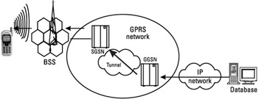
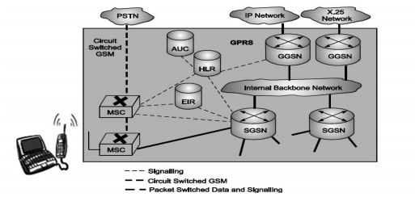
GPRS network operation: GPRS Internal Backbone
The internal backbone is an IP based network used to carry packets between different GSNs.
Tunnelling is used between SGSNs and GGSNs, so the internal backbone does not need any information about domains outside the GPRS network.
Signalling from a GSN to a MSC, HLR or EIR is done using SS7.

Slide 23
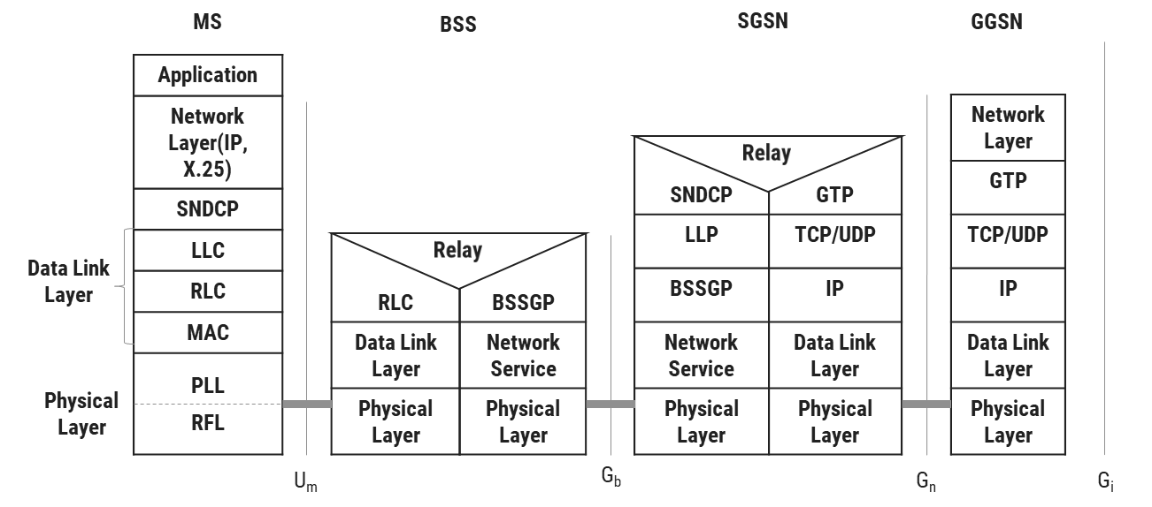
GPRS network operation: BSS-SGSN Interface
BSS-SGSN interface is divided into four layers:
Sub-Network Dependent Convergence Protocol (SNDCP) which is used to transfers data packets between SGSN and MS.
Its functionality includes:
Multiplexes several connections of the network layer onto one virtual logical connection of the underlying LLC layer.
Segmentation, compression-decompression of user data.
Logical Link Control (LLC) is a data link layer protocol for GPRS which functions similar to Link Access Procedure-D (LAPD).
This layer assures the reliable transfer of user data across a wireless network.

Slide 24
GPRS network operation: BSS-SGSN Interface
Base Station System GPRS Protocol (BSSGP) delivers routing and QoS related information between BSS and SGSN.
Network Service layer manages the convergence sub-layer that operates between BSSGP and Frame Relay.

Slide 25
GPRS network operation: Air Interface
Air interface of GPRS comprises data link layer and physical layer.
Data link layer between MS and BSS divided into three sub-layers:
Logical Link Control (LLC) layer
Radio Link Control (RLC) layer
Medium Access Control (MAC) layer
Physical layer between MS and BSS divided into two sub-layers:
Physical Link Layer (PLL)
Physical RF Layer (RFL)

Slide 26
GPRS network operation: Logical Link Control (LLC) Layer
This layer provides a reliable logical link between an MS and its assigned SGSN.
Its functionality is based on HDLC (High-Level Data Link Control) protocol.
It includes:
Sequence control
In-order delivery Flow control
Detection of transmission errors and retransmissions
Encryption is used in this interface to ensure data confidentiality.
Variable frame lengths are possible. Both acknowledged and unacknowledged data transmission modes are supported.

Slide 27
GPRS network operation: Radio Link Control Layer
Radio Link Control (RLC) layer establishes a reliable link between MS and BSS.
It also does segmentation and reassembly of LLC frames into RLC data blocks and ARQ of uncorrectable data.

Slide 28
GPRS network operation: Medium Access Control (MAC) Layer
Medium Access Control (MAC) layer controls the access attempts of an MS on the radio channel shared by several MSs.
It employs algorithms for contention resolution, multi-user multiplexing on a packet data traffic channel (PDTCH).
Scheduling and prioritizing based on the negotiated QoS.

Slide 29
GPRS network operation: Physical Link Layer(PLL)
Physical Link Layer (PLL) provides services for information transfer over a physical channel between the MS and the network.
Its functions include data unit framing, data coding and detection and correction of physical medium transmission errors.
Physical Link Layer uses the services of the Physical RF Layer.

Slide 30
GPRS network operation: Physical RF Layer(PRL)
Physical RF Layer (RFL) performs the modulation of the waveforms based on the sequence of bits received from the Physical Link Layer above.
It also demodulates received wave forms into a sequence of bits that transferred to the Physical Link layer for interpretation.

Slide 31
GPRS network operation: GRPS protocol stack
MS
BSS
SGSN
GGSN
Application
Network Layer(IP, X.25)
SNDCP
LLC
RLC
MAC
PLL RFL
Network Layer
GTP
TCP/UDP
IP
Data Link Layer
Physical Layer
Relay
SNDCP | GTP
LLP | TCP/UDP
BSSGP | IP
Network Service | Data Link Layer
Physical Layer | Physical Layer
RLC
Data Link Layer
Physical Layer
BSSGP
Network Service
Physical Layer
Data Link Layer
Relay
Physical Layer
U_{m}
G_{b}
G_{n}
G_{i}
RFL | Radio Frequency Layer
SNDCP | Subnet Dependent Convergence Protocol
PLL | Physical Link Layer
BSSGP | BSS GPRS Application Protocol
MAC | Medium Access Control
GTP | GPRS Tunneling Protocol
RLC | Radio Link Control
LLC | Logical Link Control

Slide 32
Security in GPRS

Slide 33
Security in GPRS
GPRS security is similar to the existing GSM security.
SGSN performs authentication and cipher setting procedures based on the same algorithms, keys and other criteria of GSM.
GPRS uses a ciphering algorithm optimized for packet data transmission.

Slide 34
Routing in GPRS

Slide 35
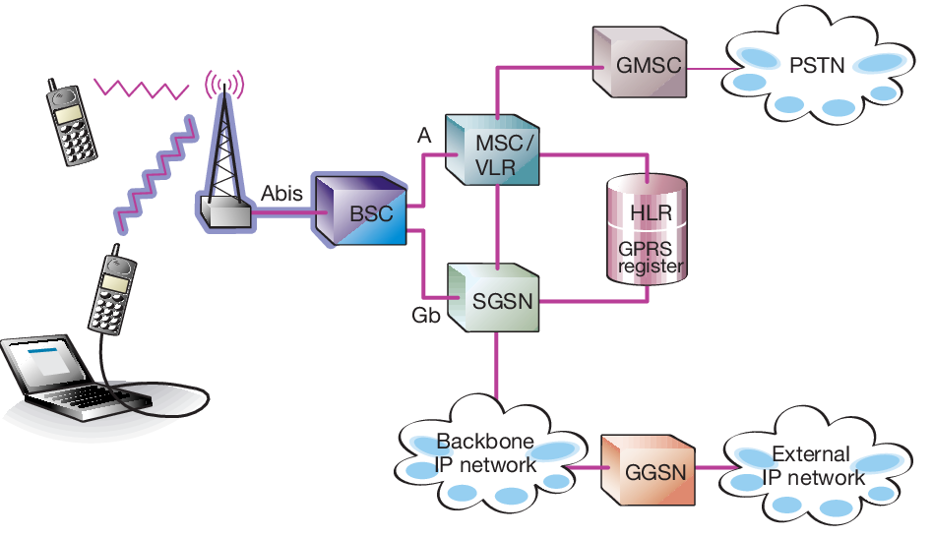
Routing in GPRS
Data routing or routing of data packets to and fro from a mobile user, is one of the pivot requisites in the GPRS network.
The requirement can be divided into two areas:
Data packet routing
Mobility management

Slide 36
Routing in GPRS
The important roles of GGSN involve synergy with the external data network.
The GGSN updates the location directory using routing information supplied by the SGSNs about the location of an MS.
GGSN routes the external data network protocol packet encapsulated over the GPRS backbone to the SGSN currently serving the MS.
It also de-encapsulates and forwards external data network packets to the appropriate data network and collects charging data that is forwarded to a charging gateway (CG).

Slide 37
Routing in GPRS
PLMN-1
PLMN-2
BSC
BSC
BTS
BTS
Inter-PLMN GPRS backbone
SGSN
SGSN
Intra-PLMN GPRS backbone
Intra-PLMN GPRS backbone
Router Gateway
Router Gateway
SGSN
GGSN
GGSN
LAN
Origin Server
Packet Data Networks(PDN)
router
SGSN that the MS is registered with encapsulates the IP packets coming from the MS, examines the PDP context and routes them through the intra-PLMN GPRS backbone to the appropriate GGSN.
GGSN de-encapsulates the packets and sends them out on the IP network, where IP routing mechanisms are used to transfer the packets to the access router of the destination network.
GPRS MS located in PLMN1 sends IP packets to a host connected to the IP network (e.g. to a Web server connected to the Internet).
An IP address has been assigned to MS by the GGSN of PLMN2 and so, MS’s IP address has the same network prefix as the IP address of the GGSN in PLMN2.
Correspondent host is now sending IP packets to the MS onto the IP network and are routed to the GGSN of PLMN2 (the home-GGSN of the MS).
The latter queries the HLR and obtains the information that the MS is currently located in PLMN1.
It encapsulates the incoming IP packets and tunnels them through the inter-PLMN GPRS backbone to the appropriate SGSN in PLMN1 while the SGSN de-encapsulates the packets.
Home-PLMN of the mobile station is PLMN2.
Finally, delivers IP packets to the host.
Finally delivers them to the MS.

Slide 38
Data services in GPRS

Slide 39
Data services in GPRS
Any user is likely to use either of the two modes of the GPRS network:
Application mode
Tunneling mode
In application mode, the user uses the GPRS mobile phone to access the applications running on the phone itself.
The phone here acts as the end user device.
In tunneling mode, user uses GPRS interface as an access to the network as the end user device would be a large device like laptop computer or a small device like PDA.
The mobile phone will be connected to the device and used as a modem to access the wireless data network.

Slide 40
Bearers in GPRS
Bearer services of GPRS offer end-to-end packet switched data transfer.
GPRS supports two different kinds of data transport services:
Point-to-point (PTP) services
Point-to-multipoint (PTM) services
GPRS continues to support SMS as a bearer.
Wireless Application Protocol is a data bearer service over HTTP protocol.
Multimedia Messaging Service supports multimedia messages.

Slide 41
Applications of GPRS
Chat
Multimedia Services
Virtual Private Network
Personal Information Management
Vehicle Positioning
Location based services and Telematics

Slide 42
GPRS: Benefits
Resources are reserved only when needed and charged accordingly
Connection setup times are reduced
Enables new service opportunities
GPRS reuses existing GSM infrastructure, therefore deployment is easier
It provides seamless and instant connectivity with the internet
Allows simultaneous use of both voice and data services. Thus user can have both voice call and data call together. Data call refers to use of internet by browsing or downloading or uploading data.

Slide 43
Limitations of GPRS
Limited Cell Capacity for All Users:
Only limited radio resources can be deployed for different uses. Both Voice and GPRS calls use the same network resources.
Network can be affected when more number of GPRS users in the same area utilize the GPRS services at the same time. This leads to congestion which results into slower data connection.
Speed Lower in Reality:
Achieving the theoretical maximum GPRS data transmission speed of 172.2 kbps would require a single user taking over all eight time slots without any error protection.
GPRS is slower compare to latest wireless standards such as HSPA, LTE, LTE-advanced etc.

Slide 44
Billing and charging in GPRS
Minimum charging information that must be collected are:
Destination and source addresses.
Usage of radio interface.
Usage of external Packet Data Networks.
Usage of the packet data protocol addresses.
Usage of general GPRS resources and location of the Mobile Station.
Various business models exist for charging customers as billing of services can be based on:
The transmitted data volume
The type of service
The chosen QoS profile.
GPRS call records generated in the GPRS Service Nodes.
Packet counts passed to a Charging Gateway that generates call detail records that sent to the billing system.

Slide 45
GPRS Billing and Charging
The SGSN and GGSN register all possible aspects of a GPRS user's behavior and generate billing information accordingly. This information is gathered in so-called Charging Data Records (CDR) and is delivered to a billing gateway.
The GPRS billing parameters:
Volume | The amount of bytes transferred, i.e., downloaded & uploaded both
Duration | Duration of a PDP context session
Time | Date, time of day and day of the week information
Final destination | A subscriber could be charged for access to the specific network, it may be a proxy server
Location | Current location of the subscriber
Quality of Service | Pay high for higher network priority
Flat rate | A fixed monthly rate
Bearer service | Charging based on different bearer services (for an operator who has several networks, such as GSM900 and GSM1800, and who wants to promote usage of one of the networks). Or, perhaps the bearer service would be good for areas where it would be cheaper for the operator to offer services from a wireless LAN rather than from the GSM network.

Slide 46
GTU Questions: Unit 3 GPRS
Sr. | Question | Marks | Year
1. | Discuss the network elements in GPRS that are different from GSM. Also discuss applications and limitations of GPRS. | 7 | Win’18
2. | Draw and explain the GPRS transmission plane protocol model. | 7 7 | Sum’19 Sum’20
3. | List and explain functionality of Serving GPRS Support Node(SGSN) and Gateway GPRS Support Node(GGSN). | 3 | Win’20
4. | Explain Voice and Data Routing in GPRS with proper diagram. | 3 | Win’19
5. | Discuss briefly: Limitations of GPRS. | 4 | Win’18
6. | How billing and charging functions are handled in GPRS? | 4 | Win’18

Slide 47

References
Book: | Mobile ComputingTechnology,Applications and service creation ,Asoke K Telukder, Roopa R Yavagal by TMH
Web: | https://www.electronics-notes.com

Slide 48
Thank You

